Slide 1

Incorporating Search into your application
Boston Code Camp 25
2016-04-02
Andrew Babiec

Slide 2













Boston Code Camp 25 - Thanks to our Sponsors!
Platinum
Gold
Silver
Bronze
In-Kind Donations

Slide 3
Agenda
Benefits
Compare and contrast options for incorporating search into your applications
Lucene, Solr, Elastic Search, Azure Search
Usage

Slide 4
Intro
Why use a search engine?
Why not just use LIKE ‘%text%’?
Notes:
http://blog.stackoverflow.com/2008/11/sql-2008-full-text-search-problems/
https://www.brentozar.com/archive/2008/11/stackoverflows-sql-2008-fts-issue-solved/

Slide 5
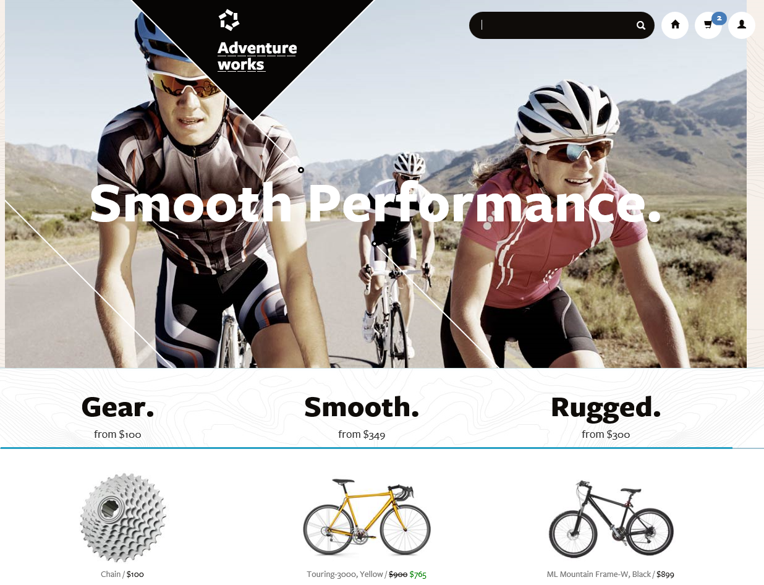

Slide 6
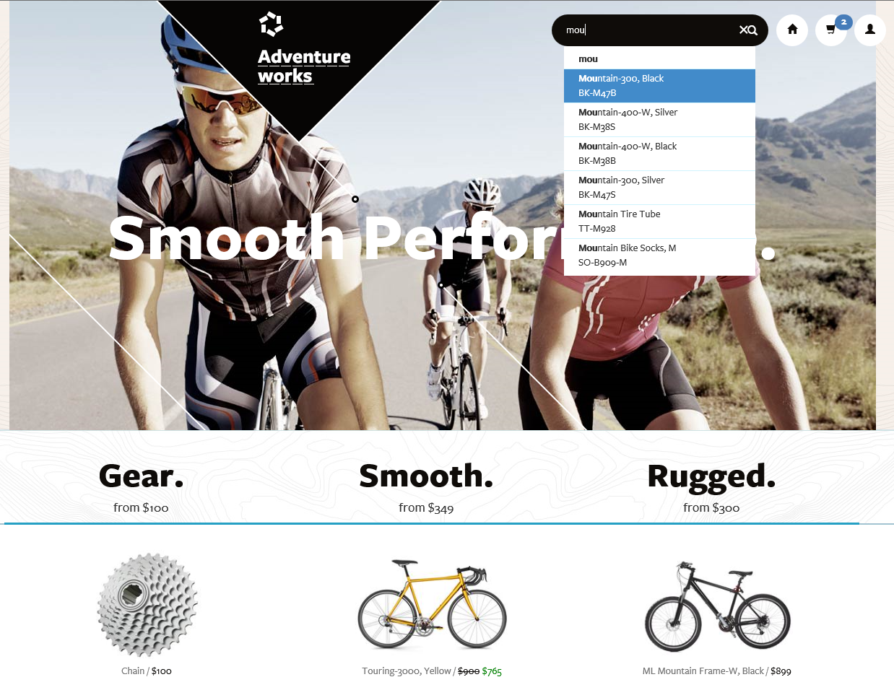
Type Ahead

Slide 7
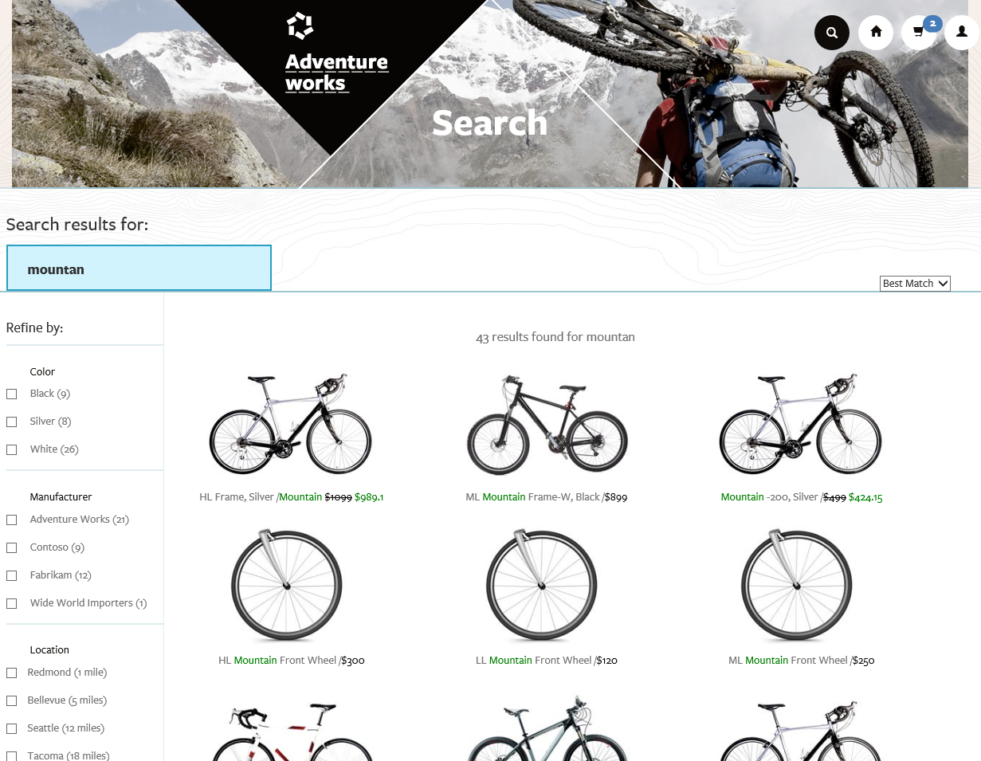

Slide 8
Facets and Filters
Spelling Mistakes
Facets

Slide 9
Hit Highlighting

Slide 10
Spelling Mistakes

Slide 11
Geo-Spatial Search

Slide 12
Paging

Slide 13
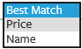
Sorting & Scoring

Slide 14
Key Search Features
Search Text: Text as written by the user used for full text search
Faceting: Aggregate counts of results by categories
Highlighting: Define fields used for hit highlighting
Filter: Used to further limit results
Sorting: Sort results by values in document fields instead of score
Paging: Limit the number of results to be returned
Projection: Limits results to a subset of the fields
Count: Total count of fetched items
Lookup: Retrieves a specific document by its key

Slide 15

eCommerce
Enable retail customers to find products through search and provide a great search experience with spelling corrections, suggestions and faceting
Fine-tuned ranking models accommodating:
Popularity and rating
Inventory
Margin, discounts and vendor promotions
High query rate

Slide 16

User Generated Content
Examples of this kind of applications include:
Knowledge base articles
Sites and apps for recipes, restaurant reviews
User-contributed news sites
Social networks and forums
Document sharing tools
Support large volumes of text-heavy documents
Ranking models connect results to business objectives
i.e., boost relevant KB articles that are newer

Slide 17

Business Applications
Enable users to navigate content using Search rather than menus and traditional access paths allowing:
Quicker, natural and more efficient information retrieval
Support for many different data types
Single entry point to discover content

Slide 18
Lucene, Solr, ElasticSearch
Search Engines

Slide 19

Apache Lucene
Apache Lucene is a free/open source information retrieval software library, written in Java
Indexing at lightning speed
Ultra-fast full-text search library
No crawler, document parsing nor search UI
see Apache Nutch, Apache Solr, Apache Tika

Slide 20
Lucene Features
Text search engine that creates indexes on our documents based on their data and characteristics, allowing fast searches including tokenization and root word analysis.
It also lets us create custom logic to ponder and score documents, so our results will match more closely what the user is trying to find.
Notes:
Originally created on Java and later ported to .Net as Lucene.net

Slide 21

Apache Solr
Open source enterprise search platform built on Apache Lucene™
Solr is highly reliable, scalable and fault tolerant, providing distributed indexing, replication and load-balanced querying, automated failover and recovery, centralized configuration and more.
Notes:
Wrapper around Lucene that provided index access through XML/HTTP services, caching and replication.

Slide 22
Solr Features
Solr offers advanced, optimized, scalable searching capabilities
Communicate with Solr using XML, JSON and HTTP
Includes a HTML admin interface
Very configurable

Slide 23

ElasticSearch
Search engine implementation using Lucene that added a REST interface, replication, faceting, filtering, JSON (schema-free) document storage, geo-localization and suggestions (among its main features).
An open-source, distributed web application written in Java, that can scale out gracefully

Slide 24
Terminology
Node = single server (elasticsearch instance)
Cluster = collection of one or more nodes
Index = collection of documents (database)
Type = logical category/partition of an Index (table)
Document = basic unit of information that can be indexed (row)
Shard = slice/partition of an Index
Replica = copy of a shard

Slide 25
Official ElasticSearch Clients
Java, JavaScript, PHP, Perl, Python, Ruby
Two official .NET clients:
ElasticSearch.Net
Low-level client, no dependencies
Generated from the elasticsearch REST API spec
Load balancing / cluster failover support
NEST
High-level client, strongly-typed, relies on JSON.NET
Provides types request and response objects
Built on top of ElasticSearch.Net
Fluent API
Load balancing/connection failover

Slide 26
Solr vs. ElasticSearch
ElasticSearch distributed at its core (shards)
SolrCloud = cluster of Solr servers, requires ZooKeeper
Solr default is XML, but supports JSON, CSV
ElasticSearch is natively JSON, designed with a RESTful API from the onset
Notes:
https://nickcraver.com/blog/2016/02/17/stack-overflow-the-architecture-2016-edition/
Each Elastic cluster (there’s one in each data center) has 3 nodes, and each site has its own index. Careers has an additional few indexes. What makes our setup a little non-standard in the elastic world: our 3 server clusters are a bit beefier than average with all SSD storage, 192GB of RAM, and dual 10Gbps network each.
The main reason we’re on Elasticsearch instead of something like SQL full-text search is scalability and better allocation of money. SQL CPUs are comparatively very expensive, Elastic is cheap and has far more features these days. Why not Solr? We want to search across the entire network (many indexes at once), and this wasn’t supported at decision time. The reason we’re not on 2.x yet is a major change to “types” means we need to reindex everything to upgrade. I just don’t have enough time to make the needed changes and migration plan yet.
Elasticsearch Servers (Search)
3 Dell R620 Servers, each with:
Dual E5-2680 Processors (8 cores @2.7–3.5GHz each)
192 GB of RAM (12x 16 GB DIMMs)
2x Intel S3500 800GB SATA SSDs (RAID 1)
Dual 10 Gbps network (Intel X540/I350 NDC)

Slide 27
Connecting
var node = new Uri("http://servername:9200");
var settings = new ConnectionSettings(node);
settings.DefaultIndex(“myindex");
var client = new ElasticClient(settings);

Slide 28
Querying
string q = “Boston";
var result = client.Search<Location>(body =>
// return first 25 results, default is 10
body.Size(25).Query(query =>
query.QueryString(qs => qs.Query(q))));
if(result.IsValid)
{
IEnumerable<Location> locations = result.Documents;

Slide 29
Azure Search
Search-As-A-Service

Slide 30
Azure Search
A search-as-a-service solution allowing developers to incorporate great search experiences into applications without managing infrastructure or needing to become search experts.
Notes:
using ElasticSearch as its underlying engine

Slide 31
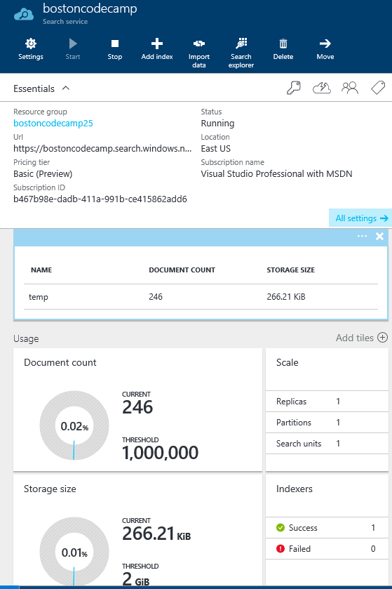
Create a Search Service
Use Azure portal or API to create a search service that will hold one or more search indexes, defining:
Geographic location
Azure Subscription
Scale of service

Slide 32
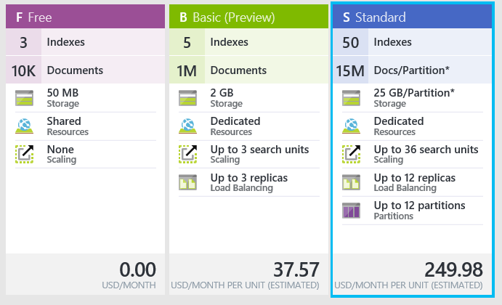
Pricing

Slide 33
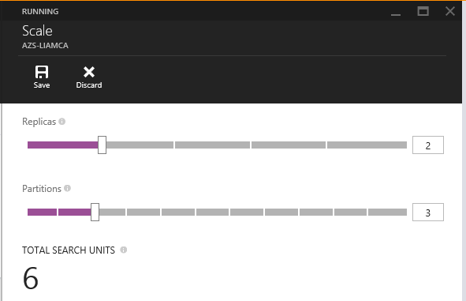
Scaling Azure Search
Capacity can dialed up and down at the search service level for standard services
Added capacity will increase queries per second, number of documents uploaded/updated per second and total count of documents in the search service
Billing is connected to capacity
Azure Search is designed to handle applications with hundreds of queries per second and millions of documents per search service

Slide 34
What is a Search Index?
Consists of fields and documents and is the container used to execute search queries against
Similar in concept to a SQL “table” (but not to be confused with a SQL Index)
Fields have properties such as “Searchable” and “Facetable”
Documents are uploaded to the Search index

Slide 35
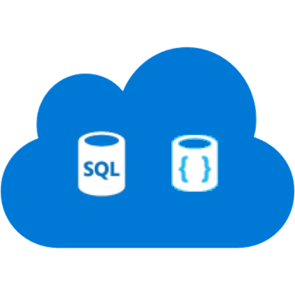

Indexing Data Options
Push - using indexing API
POST to /indexes/<name>/docs/index
Up to 1000 actions per batch
Actions can be upload, merge, delete, etc.
WebJobs are great for regular execution
Great for near real-time updates
Pull - using indexers
Azure SQL DB and DocumentDB
Change detection, deletion markers
Point it at the data source, define policy, done
Runs as often as every 5 min

Slide 36
Suggestions (Auto-Complete)
Allows developers to provide type-ahead suggestions as the user types
Provides mechanism for users to find content quickly
Supports:
Infix matching for suggestions
Optional fuzzy matching enabling more flexibility for spelling mistakes
Support for up to 100 suggestions per result
No limit in length other than field limits
No minimum length to number of characters used

Slide 37

Ranking & Tuning a Search Index
Scoring refers to the computation of a search score for every item returned in search results
Is an indicator of an item's relevance in context of the current search operation
Higher score, means more relevancy and will boost item in search results
Scoring can be customized using scoring profiles
Scoring profiles allow you to boost items based business value or to improve user experience
E.g., Promote newer items, or boost items that have been in inventory too long

Slide 38
Scoring Profiles
Scoring profile is part of index definition and can include:
Weighted fields: Assigns a relative weight to a field in the case where a search result found in one field is more important than another
Freshness: Allows weighted boosting of new or old an item is using a datetime fields
Magnitude: Enables boosting based on how high or low a numeric value is such as a product rating
Distance: Provided boosting based on proximity or geographic location of item to that of a location specified by the users using a geo.distance fields
Tag Boosting: Affects scoring based on common tags in document and search queries

Slide 39
Geo-Spatial Search
Allows developer to store and query data that represents objects defined in a geometric space including:
Distance: Given a points stored within the search index and one passed by the user, calculate the distance
Intersection: Determine if a given point stored in the index is within a given polygon supplied by the user
Can be used in filters, sorting and scoring profiles

Slide 40
Multilanguage Search
Support for 50 languages
Word breaking, stop words, inflections
Lucene analyzers
Well-known analyzer stack
Stemming
Microsoft analyzers
Same NLP stack used by parts of Office, Bing
Lematization in many languages
Provides an even deeper understanding of the languages (plurality, masculine, feminine, etc)
Notes:
Lemmatisation - the verb 'to walk' may appear as 'walk', 'walked', 'walks', 'walking'.
The word "better" has "good" as its lemma. This link is missed by stemming, as it requires a dictionary look-up.
The word "walk" is the base form for word "walking", and hence this is matched in both stemming and lemmatisation.
The word "meeting" can be either the base form of a noun or a form of a verb ("to meet") depending on the context, e.g., "in our last meeting" or "We are meeting again tomorrow". Unlike stemming, lemmatisation can in principle select the appropriate lemma depending on the context.

Slide 41
Provision service
Search + typical data operations
Simple search options, + - * () “”
Filter, sort, project, page over results
Options work with search and suggest
Search from client or server
Use query keys when searching from clients
CORS allows direct calls from browsers
Render from search results
Include necessary non-searchable data
E.g. URLs for pictures, keys to main content
Create index
Index data
Search

Slide 42
Resources
Azure Search Product Page
http://azure.microsoft.com/en-us/services/search/
Azure Search Docs & Tutorials
http://azure.microsoft.com/en-us/documentation/services/search
ElasticSearch https://www.elastic.co/
Solr http://lucene.apache.org/solr/
Lucene http://lucene.apache.org/
ababiec@Tallan.com

Slide 43

Recommended Resources
Demos from Today (Github)
Azure Search Course (MVA)
MSDN Documentation
Introduction to Azure Search
Scenarios and Capabilities
Azure Search Technical Overview
Service REST API
Get started with Azure Search in:
.NET
Java
NodeJS

